Slide 1
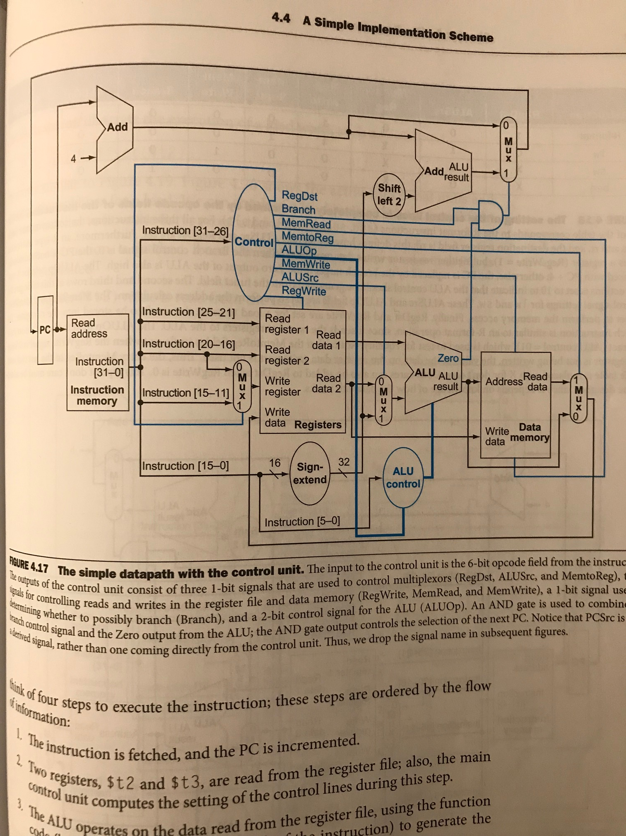
Add_1_out
Add_1_out
branch_mux_out
Shift_left_2
Add_2_out
branch_mux_sel
Alu_zero
Read_data_1
Read_data_2
Data_mem_out
Pc_out
Alu_result
Ins_mem_out
Mux_write_reg
Mux_read_reg
z
Ext_out

